Slide 1
Introduction to ML
For Internal Use: Version-DSPG 2023

Slide 2
Disclaimer
The following content is designed to work for audiences across multiple levels of familiarity with ML, and can come across as reductive or over-simplified.
This is part of a background to BERT for NLP purposes so most of the focus is on NLP related topics, which is just one vertical slice of the ML org chart, because it’s a common use case for our lab.
Changes, updates, improvements happen frequently, literally weekly. So in case there are statements here that say ‘The best method’ or ‘state of the art’, just add ‘as of early June 2023’

Slide 3
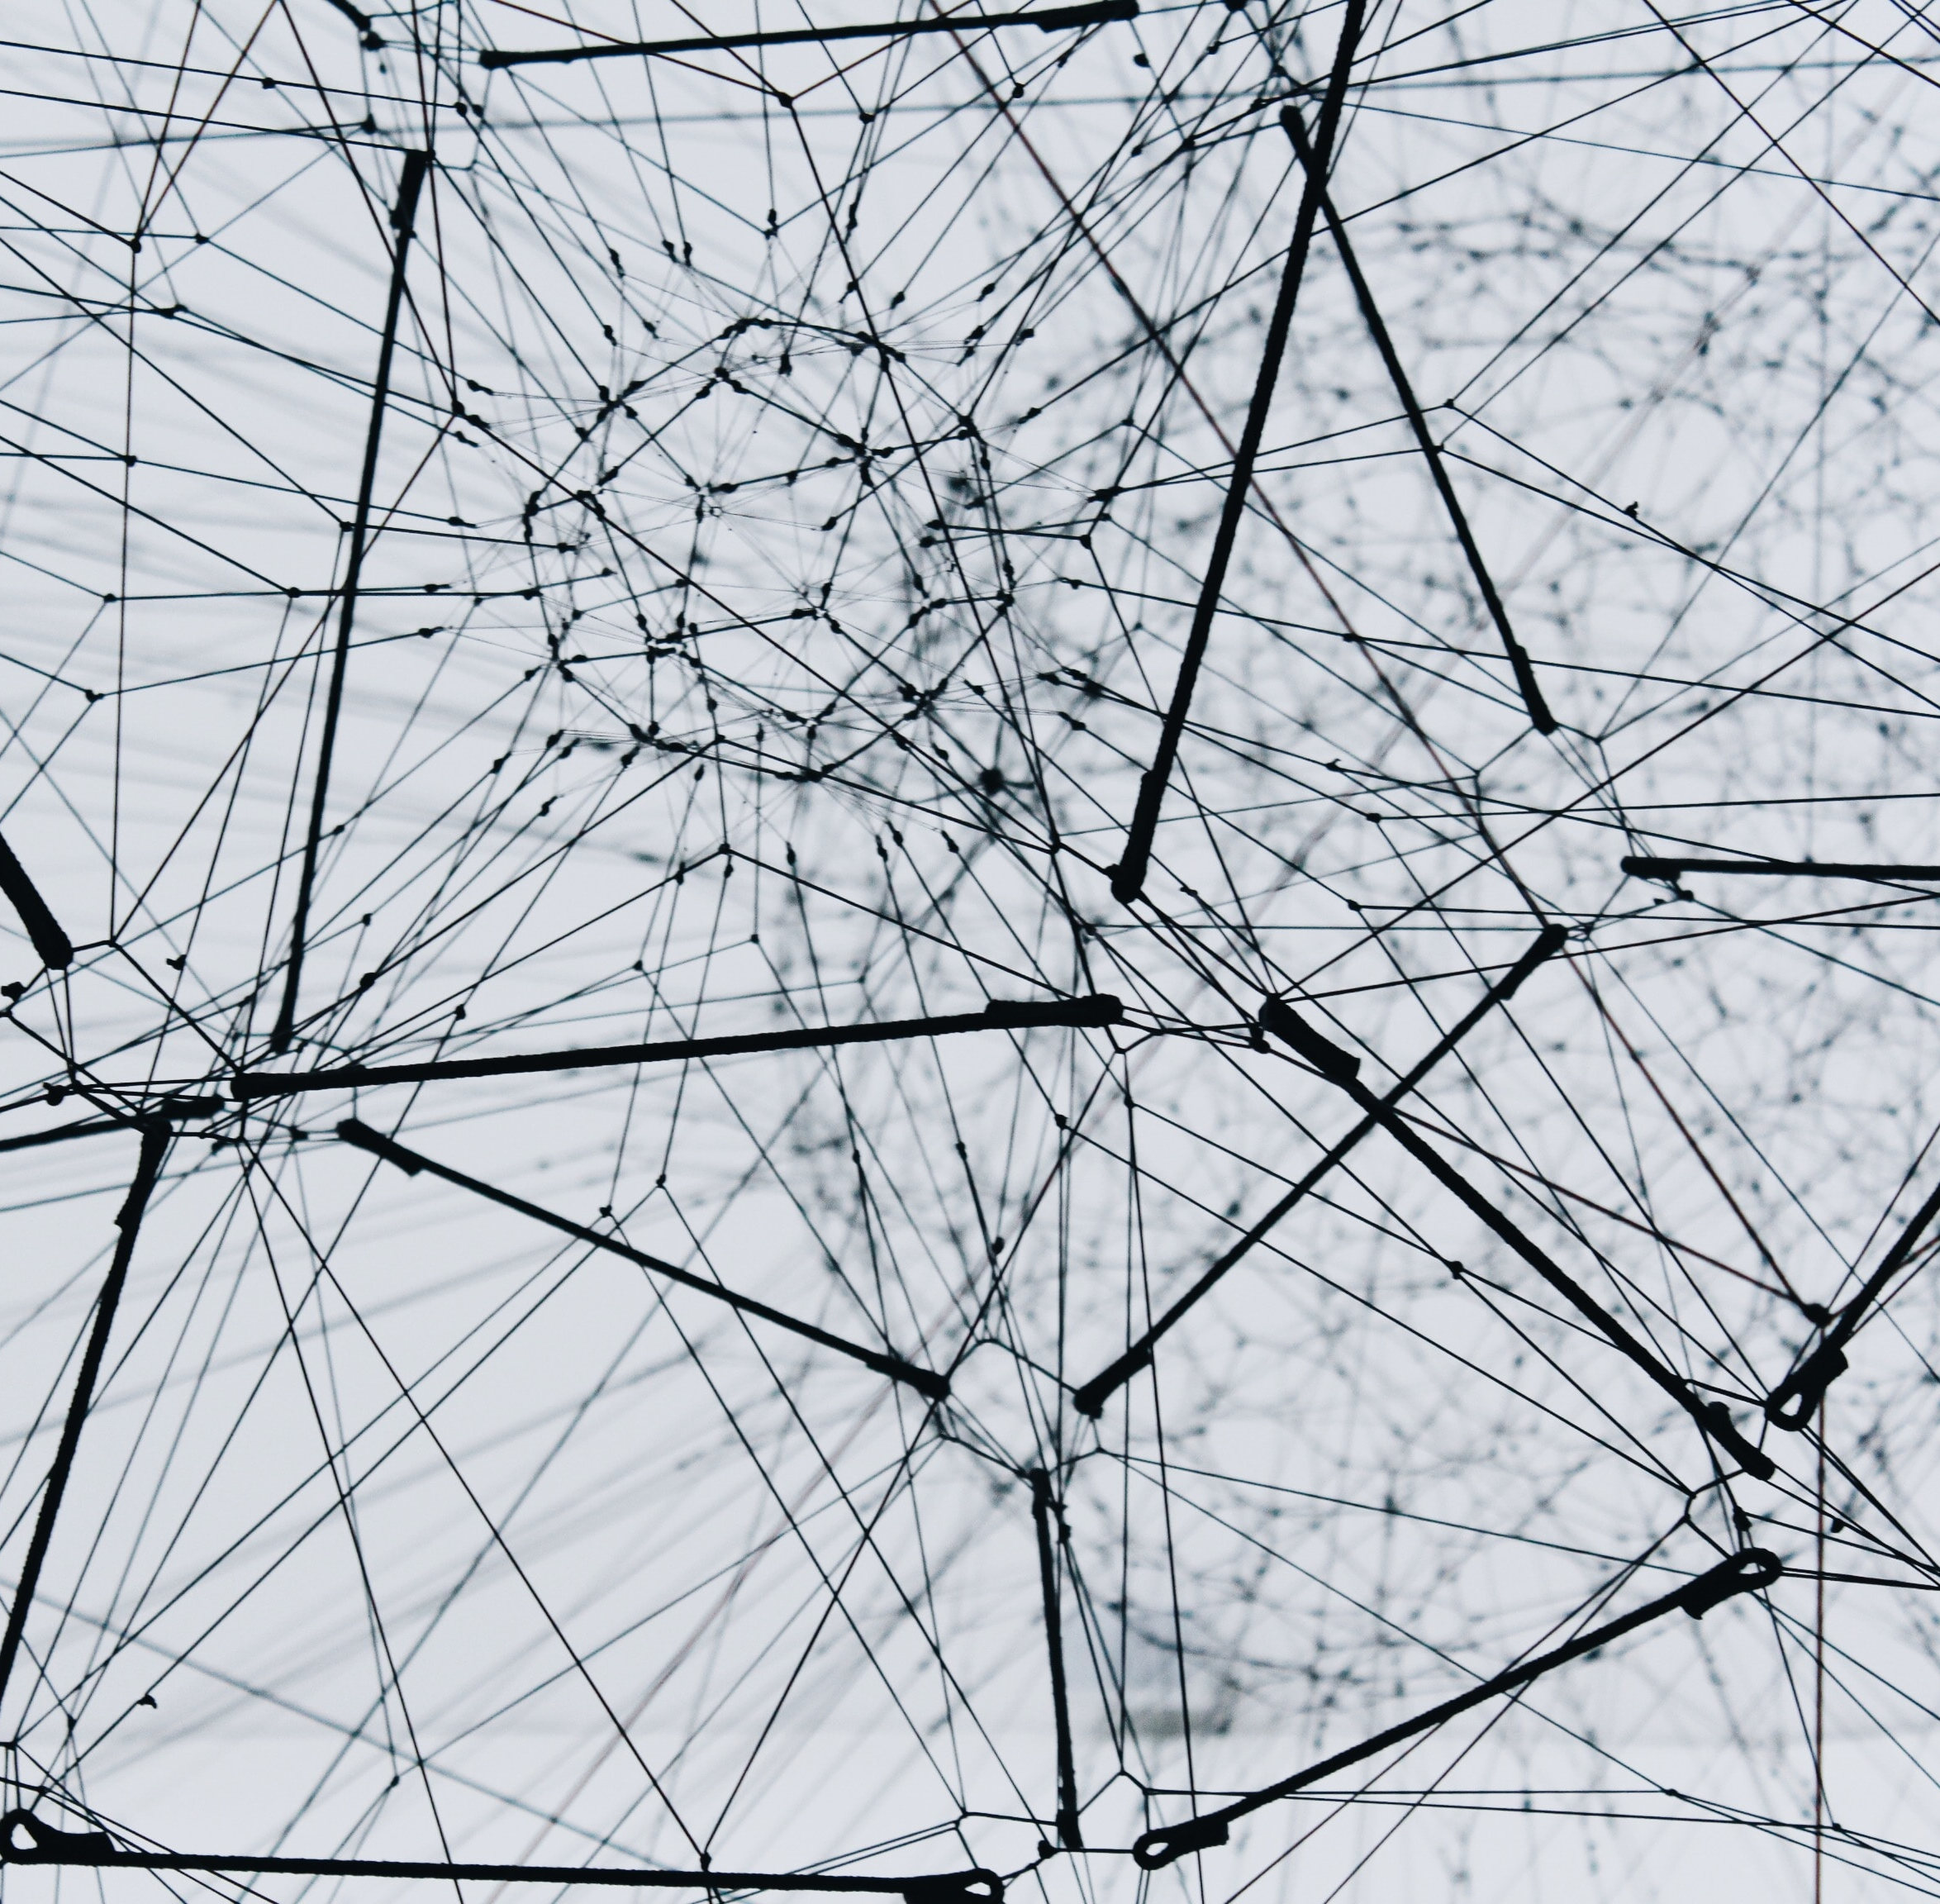
Introduction
Machine Learning is a subset of Artiﬁcial Intelligence that enables systems to learn from data, identify patterns and make predictions.
(IBM Definition) Machine learning is a branch of artificial intelligence (AI) and computer science which focuses on the use of data and algorithms to imitate the way that humans learn, gradually improving its accuracy.

Slide 4
Machine Learning
We have features. We use them to make predictions. - The sky is overcast and the clouds are grey. It might rain
The blue words describe observed features and the red words describe an outcome.

Slide 5
Problem – Will we play pickleball today
Features:
Is the player feeling tired? (on a scale from 1 to 5, 1 meaning not at all tired, 5 meaning exhausted)
Does the weather report say it will rain? (Probability of rain, from 0% to 100%)
Temperature
Does the player have other activities that take precedence? (work, prior engagements) (Boolean 0 or 1)
Is the game at 10:10PM?
Other factors? (Student suggestion time)
Is there a league game that we are scheduled to play? (Boolean 0 or 1)

Slide 6
Takeaways?
Capturing as much information as possible, without losing vital details.
Some Features are stronger predictors than others
Input Features need to be formatted as numeric
Yes or No replaced with Boolean 0 or 1
Fill in missing values (with a placeholder or with a mean value or 0)
Categorical Variables convert using various methods
One-Hot Encoding
Ordinal Encoding (Assigns a number to a datapoint based on sequence order)
Frequency Encoding (Encode based on the proportion that a datapoint occurs in a column)
Images, Audio, Text, all have specialized approaches to convert to numeric

Slide 7
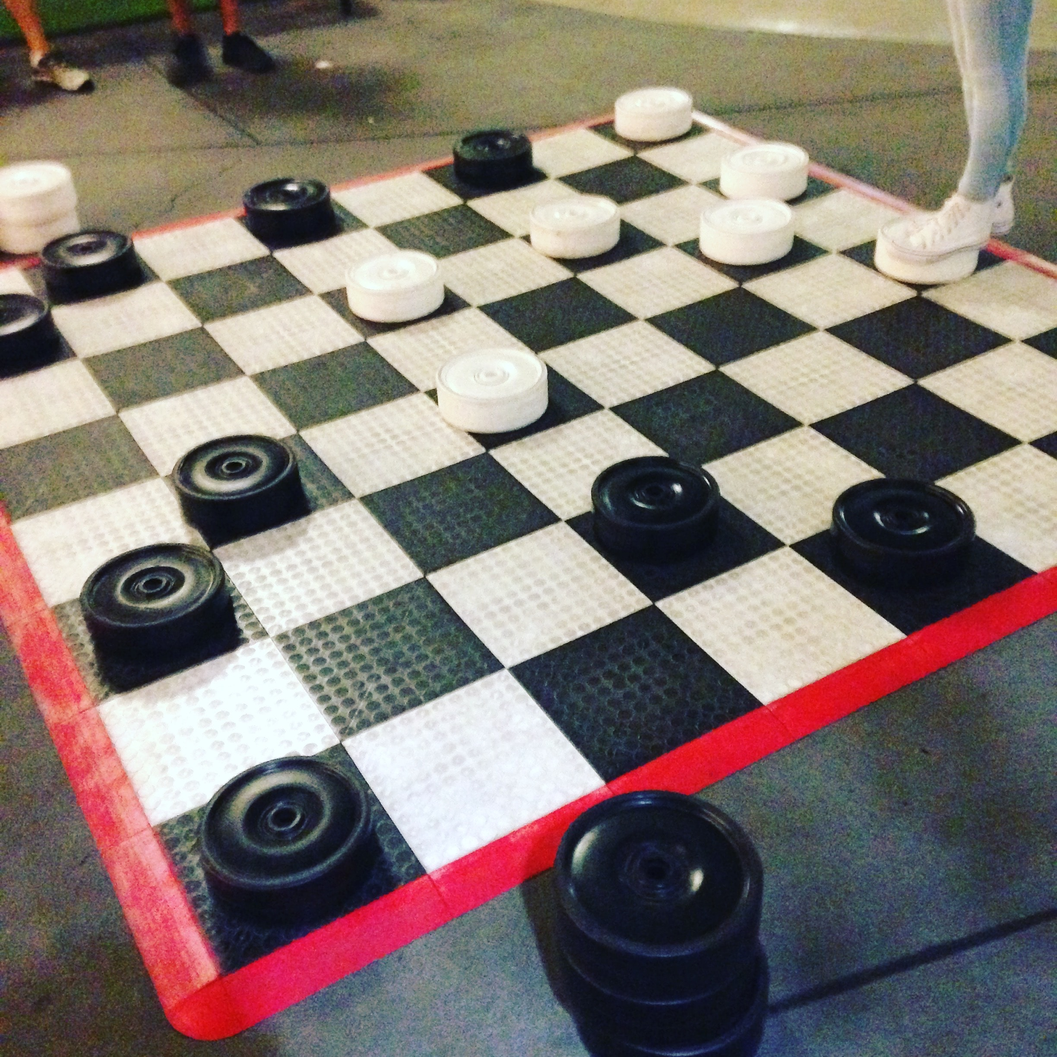
Origin
Arthur Samuel of IBM developed a computer program for playing checkers in the 1950s. Since the program had a very small amount of computer memory available, Samuel initiated what is called alpha-beta pruning. His design included a scoring function using the positions of the pieces on the board. The scoring function attempted to measure the chances of each side winning. The program chooses its next move using a minimax strategy, which eventually evolved into the minimax algorithm.
Samuel also designed a number of mechanisms allowing his program to become better. In what Samuel called rote learning, his program recorded/remembered all positions it had already seen and combined this with the values of the reward function. Arthur Samuel coined the phrase “machine learning” in 1952.

Slide 8
ML Types
3 main types of Machine learning Methods
Supervised
Learning
Unsupervised Learning
Reinforcement
Learning
Supervised Learning involves training a model using labeled data
Unsupervised Learning involves discovering patterns in unlabeled data.
Reinforcement Learning involves training a model to make decisions based on trial and error.
​

Slide 9
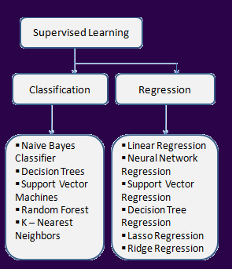
Supervised Learning
rEGRESSION
Used to predict real values
Examples: Forecasting future data (Extrapolation)
Financial forecasting, house prices, stock prices, sales forecasting
cLASSIFICATION
Used to predict categories
Examples: Spam Detection, Image classification, Shazam, DNA Sequence classification

Slide 10

Classification

Slide 11
ML Methods: Gaussian NAÏVE BAYES
Most basic algorithm for categorization and classification, we use this as a baseline
Naive Bayes classifiers assume that the value of a particular feature is independent of the value of any other feature, given the class variable.
For example, a fruit may be considered to be an apple if it is red, round, and about 10 cm in diameter.
Each of the features contributes independently to the probability
This fruit is an apple, regardless of any possible correlations between the color, roundness, and diameter features
Gaussian Naïve Bayes assumes real valued inputs. It works best with TFIDF, because each word has a real number score associated with the presence of the word
It can’t be applied to Term-Frequency Matrices because they’re sparse (word frequency in documents does not follow a Gaussian distribution)
Notes:
Gaussian Inputs: If the input variables are real-valued, a Gaussian distribution is assumed. In which case the algorithm will perform better if the univariate distributions of your data are Gaussian or near-Gaussian. This may require removing outliers (e.g. values that are more than 3 or 4 standard deviations from the mean). Maybe this is why Gaussian NB has low AUC

Slide 12
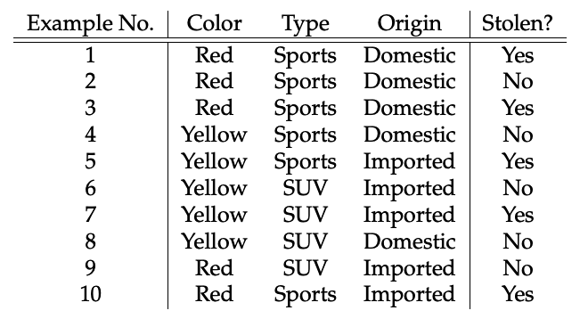
GTA Dataset
https://medium.com/analytics-vidhya/naive-bayes-729ac4ca48a8
Notes:
These are the features of a vehicle. https://medium.com/analytics-vidhya/naive-bayes-729ac4ca48a8

Slide 13
Would a Red Domestic SUV get stolen?
Using Naïve Bayes, P(A|B)=P(A)*P(B|A)/P(B)
…
This is the simplest equation we can use for this kind of calculation, and I’m not going to dwell on this much, considering there’s a lot to get through. Also I’m pretty sure this stuff is covered in math, stats and CS classes so you are probably all familiar with it anyway. If not, I would encourage giving this a read. https://medium.com/analytics-vidhya/naive-bayes-729ac4ca48a8
Long story short-
Calculate the probability of a thing happening
Calculate the probability of the thing not happening. Higher number wins.

Slide 14
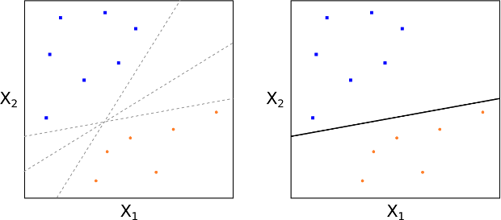
Methods: SVM
The goal of the SVM is to train a model that assigns new unseen objects into a particular category.
It achieves this by creating a linear partition of the feature space into two categories.
Based on the features in the new unseen objects (e.g. articles), it places an object "above" or "below" the separation plane, leading to a categorisation (e.g. Innovative or non-innovative).

Slide 15
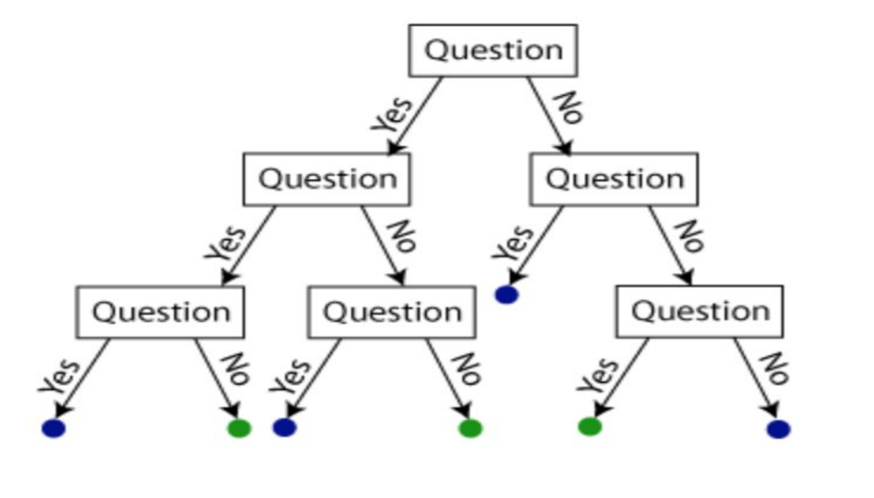
Methods: Decision Trees
A decision tree is a decision support tool that uses a tree-like graph or model of decisions and their possible consequences
○ Decision trees stratify or segment the predictor space into a number of sub regions.
○ A decision tree is a flowchart-like structure in which each internal node represents a "test" on an attribute (e.g. whether a coin flip comes up heads or tails).
○ Each branch represents the outcome of the test.
○ Each leaf node represents a class label
○ The paths from root to leaf represent classification rules.

Slide 16
Methods: Random Forests
A random forest consists of multiple random decision trees.
The results from each of the tree are taken and the final result is declared accordingly. Voting and averaging is used to predict in case of classification and regression respectively.
Two types of randomness are built into the trees.
First, each tree is built on a random sample from the original data.
Second, at each tree node, a subset of features are randomly selected to generate the best split.

Slide 17
Linear Regression
Linear regression is a type of supervised machine learning algorithm that computes the linear relationship between a dependent variable and one or more independent features.
The goal of the algorithm is to find the best linear equation that can predict the value of the dependent variable based on the independent variables. The equation provides a straight line that represents the relationship between the dependent and independent variables
Linear regression is a powerful tool for understanding and predicting the behavior of a variable, however, it needs to meet a few conditions in order to be accurate and dependable solutions.
Linearity: The independent and dependent variables have a linear relationship with one another. This implies that changes in the dependent variable follow those in the independent variable(s) in a linear fashion.
Independence: The observations in the dataset are independent of each other. This means that the value of the dependent variable for one observation does not depend on the value of the dependent variable for another observation.
Homoscedasticity: Across all levels of the independent variable(s), the variance of the errors is constant. This indicates that the amount of the independent variable(s) has no impact on the variance of the errors.
Normality: The errors in the model are normally distributed.
No multicollinearity: There is no high correlation between the independent variables. This indicates that there is little or no correlation between the independent variables.

Slide 18
LASSO Regression
Least absolute shrinkage and selection operator; also Lasso or LASSO) is a regression analysis method that performs both variable selection and regularization in order to enhance the prediction accuracy and interpretability of the resulting statistical model
As the name suggests, it’s a shrinking technique, The primary goal of LASSO regression is to find a balance between model simplicity and accuracy. LASSO particularly useful for feature selection, as it can automatically identify and discard irrelevant or redundant variables.
Regularization: A method to solve the problem of overfitting
Overfitting: An issue where an ML model gives accurate predictions for training data but not for new datasets
Often can happen if a model is too complex and starts to capture noise and expect the patterns in the noise to repeat in real world data.
ridge Regression
Ridge regression is a way to create a parsimonious model when the number of predictor variables in a set exceeds the number of observations, or when a data set has multicollinearity (correlations between predictor variables).

Slide 19
Neural Networks : Origin Story
Machine learning is, in part, based on a model of brain cell interaction. The model was created in 1949 by Donald Hebb in a book titled “The Organization of Behavior.” The book presents Hebb’s theories on neuron excitement and communication between neurons.
Hebb wrote, “When one cell repeatedly assists in firing another, the axon of the first cell develops synaptic knobs (or enlarges them if they already exist) in contact with the soma of the second cell.” Translating Hebb’s concepts to artificial neural networks and artificial neurons, his model can be described as a way of altering the relationships between artificial neurons (also referred to as nodes) and the changes to individual neurons. The relationship between two neurons/nodes strengthens if the two neurons/nodes are activated at the same time and weakens if they are activated separately. The word “weight” is used to describe these relationships, and nodes/neurons tending to be both positive or both negative are described as having strong positive weights. Those nodes with opposite weights develop strong negative weights (e.g. 1×1=1, -1x-1=1, -1×1=-1)

Slide 20
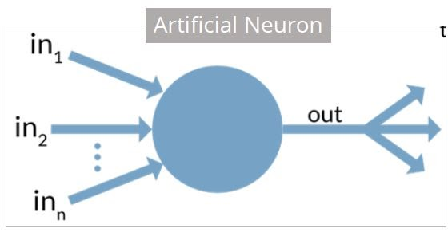
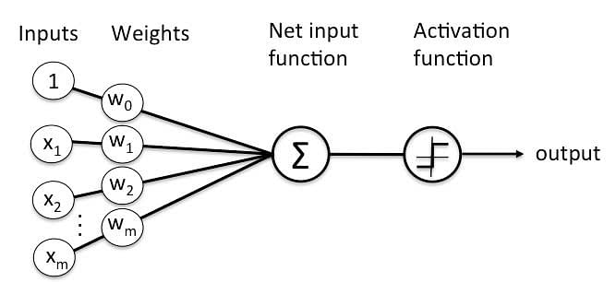
Perceptrons (1957)
Neural Networks are based on the way the human brain works, and the brain is a collection of nerve cells, or neurons. A simplified model of a nerve cell suggests that they take input signals, and based on inputs, fire an output signal
This, modeled as an algorithm, is called a Perceptron, which is a binary classifier. It consists of inputs, which are each weighted (to indicate varying importance). The weighted inputs are combined and fed to an activation function, which determines the threshold above which the output state changes.

Slide 21
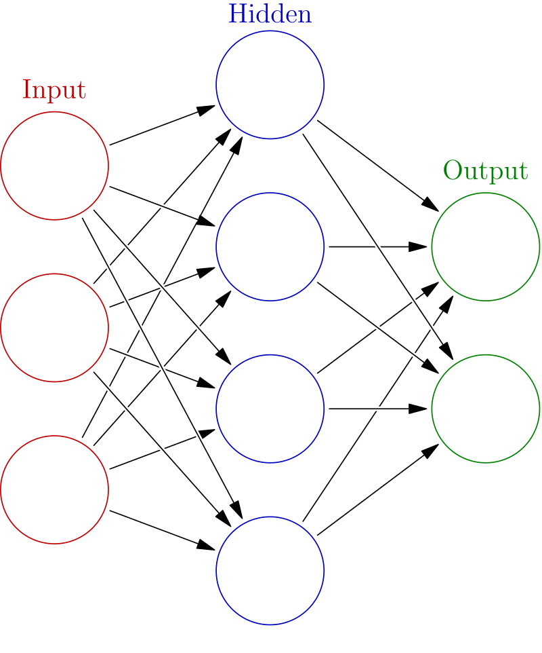
Neural Networks Learning
The first deep learning MLP was published by Alexey Grigorevich Ivakhnenko and Valentin Lapa in 1965
This example is of a Feed-Forward Neural Network

Slide 22
Neural Networks Currently
Neural Nets get complicated real quick.
Feed forward Neural nets used Gradient Descent to adjust weights
A better way to train these networks was through Backpropogation to adjust weights and improve accuracy (1970)
Post this was a period where tech was advanced enough simple neural nets were being outperformed by linear classifiers in most applications, followed by:
Convolutional Neural networks (proposed 1980, fully implemented 1989) included the idea of pooling neurons after the input layer that combined together related features. Works best for images and was applied by Yann LeCun to recognize handwritten zip codes.
Deep Learning, where more hidden layers are added to improve fine tuned classification detail, were initially developed in 1992 and became practically applicable in the early 2000s where computer hardware for these models was getting faster and becoming cheaper to put together.
Deep Learning and Convolutional Neural Networks remain King, more or less, until Long Short-Term memories started to gain popularity in the early 2010s
https://towardsdatascience.com/the-mostly-complete-chart-of-neural-networks-explained-3fb6f2367464

Slide 23
unSupervised Learning
clustering
groups unlabeled data based on their similarities or differences
K Means Clustering, Hierarchical Clustering
Association rules
Apriori Algorithms, Recommender Systems
rule-based method for finding relationships between variables in a given dataset
Dimensionality Reduction
Examples: PCA, Singular Value Decomposition
technique used when the number of features, or dimensions, in a given dataset is too high
Language models
Examples: ChatGPT, BERT, ELMo
Language Models are technically Unsupervised Multitask Learners

Slide 24
Challenges with Unsupervised Learning:
How do we know if results are meaningful since no answer labels are available?
Get an expert to look at the results (external evaluation)
Develop an objective scoring function based on clustering (internal evaluation)
Why Unsupervised Learning is needed despite of these issues?
Annotating large datasets is very costly and hence we can label only a few examples manually. Example: Speech Recognition
There may be cases where we don’t know how many/what classes is the data divided into. Example: Data Mining
We may want to use clustering to gain some insight into the structure of the data before designing a classifier.

Slide 25
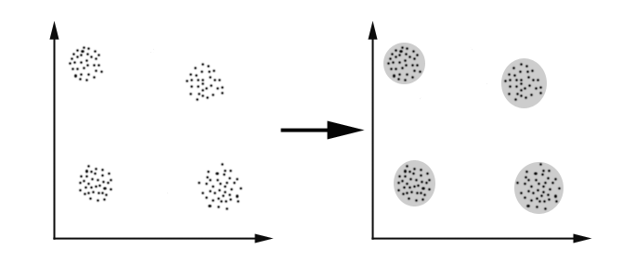
Clustering
deals with finding a structure in a collection of unlabeled data. A loose definition of clustering could be “the process of organizing objects into groups whose members are similar in some way”. A cluster is therefore a collection of objects which are “similar” between them and are “dissimilar” to the objects belonging to other clusters.

Slide 26
Clustering continued
For clustering, we need to define a proximity measure for two data points. Proximity here means how similar/dissimilar the samples are with respect to each other.
There are various similarity measures which can be used.
Vectors: Cosine Distance
Sets: Jaccard Distance
Points: Euclidean Distance
A “good” proximity measure is VERY application dependent. The clusters should be invariant under the transformations “natural” to the problem.

Slide 27
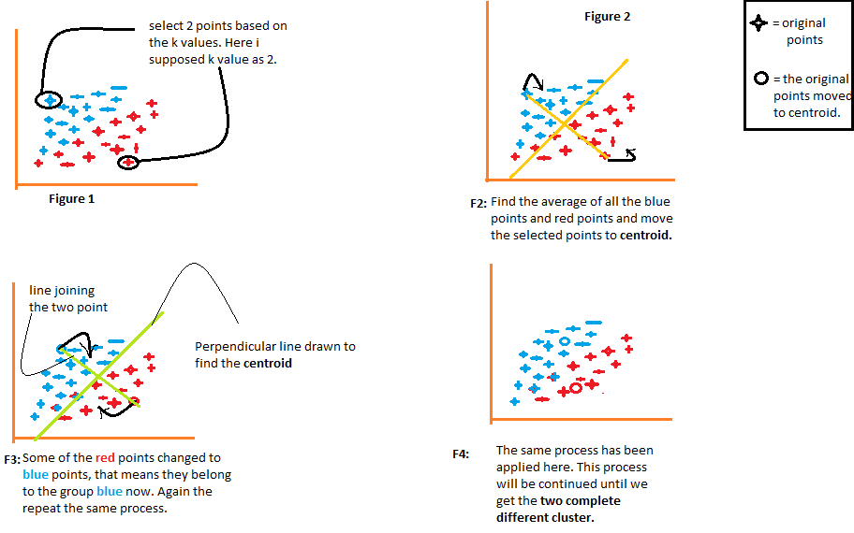
Clustering methods
Several methods exist to do clustering, one commonly used approach is K-Means
There happen to be a lot more options:
Density-Based Clustering
DBSCAN (Density-Based Spatial Clustering of Applications with Noise)
OPTICS (Ordering Points to Identify Clustering Structure)
HDBSCAN (Hierarchical Density-Based Spatial Clustering of Applications with Noise)
Hierarchical Clustering
Fuzzy Clustering
Partitioning Clustering
PAM (Partitioning Around Medoids)
Grid-Based Clustering

Slide 28
Dimensionality Reduction
The number of input variables or features for a dataset is referred to as its dimensionality.
Dimensionality reduction refers to techniques that reduce the number of input variables in a dataset.
More input features often make a predictive modeling task more challenging to model, more generally referred to as the curse of dimensionality.
High-dimensionality statistics and dimensionality reduction techniques are often used for data visualization. Nevertheless these techniques can be used in applied machine learning to simplify a classification or regression dataset in order to better fit a predictive model.
PRINCIPAL COMPONENTS ANALYSIS or PCA is the most popular method
Non-negative matrix factorization (NMF)
Kernel principal component analysis
Graph-based kernel PCA
Linear discriminant analysis (LDA)
Generalized discriminant analysis (GDA)
Autoencoder
t-SNE T-distributed Stochastic Neighbor Embedding (t-SNE)
UMAP
Main article: Uniform manifold approximation

Slide 29
Association rules
Association rules are made by searching data for frequent if-then patterns and by using a certain criterion under Support and Confidence to define what the most important relationships are. Support is the evidence of how frequent an item appears in the data given, as Confidence is defined by how many times the if-then statements are found true.
Examples:
Netflix Recommended Queue
Amazon “People who bought, also bought”
Every subscription box service that claims to offer a tailored experience

Slide 30
Applying this concept to Natural Language Processing
Machine learning algorithms cannot work with raw text directly; the text must be converted into numbers. Specifically, vectors of numbers
On a very basic level in computational linguistics, we would use words as features.
The beginner versions of NLP algorithms use the concept of ‘word frequencies’
a frequency list is a sorted list of words (word types) together with their frequency, where frequency here usually means the number of occurrences in a given corpus

Slide 31
Perceptrons (1957)
Neural Networks are based on the way the human brain works, and the brain is a collection of nerve cells, or neurons. A simplified model of a nerve cell suggests that they take input signals, and based on inputs, fire an output signal
This, modeled as an algorithm, is called a Perceptron, which is a binary classifier. It consists of inputs, which are each weighted (to indicate varying importance). The weighted inputs are combined and fed to an activation function, which determines the threshold above which the output state changes.

Slide 32
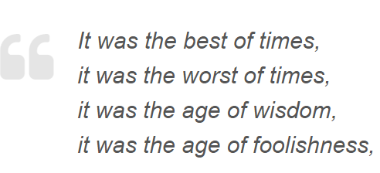
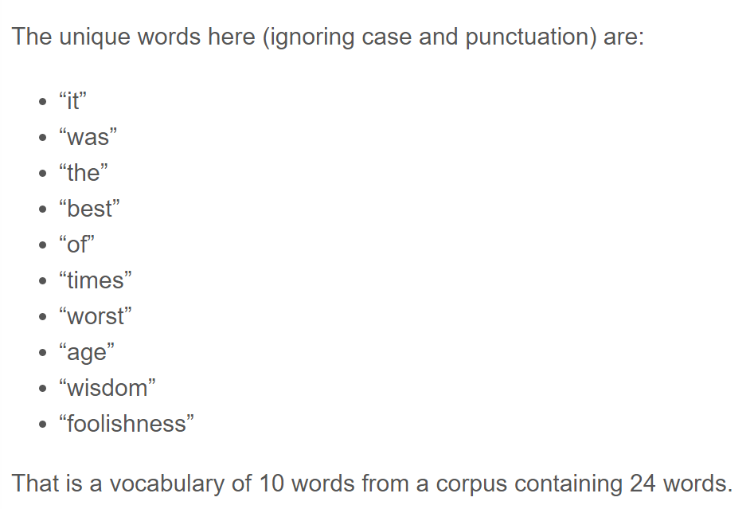
What the Dickens?
Notes:
https://machinelearningmastery.com/gentle-introduction-bag-words-model/

Slide 33
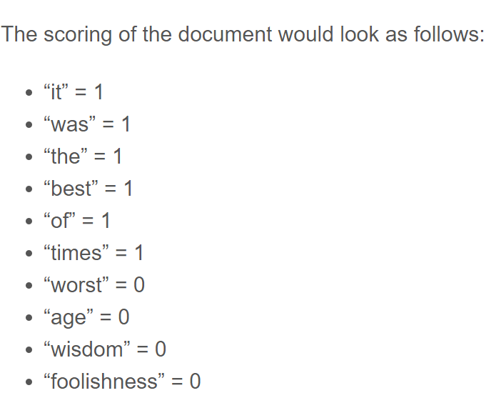
Bag of Words

Slide 34
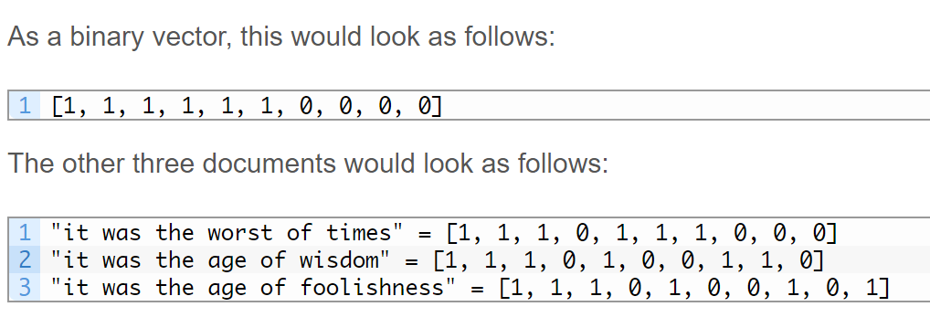
Representing Text as Vectors

Slide 35
Why are we doing this?
ML algorithms require numerical features, or features that can be quantized.
Even features that are classes, like the color of a car in the previous example, gets internally coded as a numerical value. (Yellow may be 0, Red may be 1, etc.)
What this tells you is that to use ML, you need your data to be represented in a format that’s usable.

Slide 36
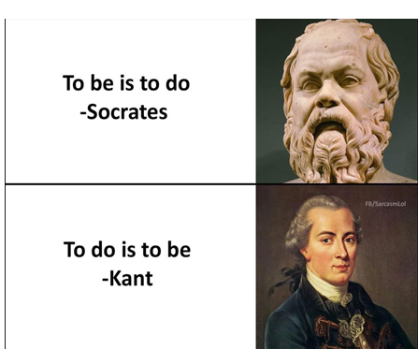
We could have better representation
Bag of words discards word position in a sentence.
This means:
Amounts to the same thing according to word frequency representations

Slide 37
How do we improve model performance?
Get more data: If the classes are well defined, if the documents being classified are reasonably long enough to help mitigate the shortcomings in data representation.
Use a more advanced algorithm- Throw more computing power at the issue
Improve data representation- Figure out a better way to represent these documents where you aren’t losing as much information when formatting it for ML

Slide 38
Not text representation, but text embeddings
Word2Vec
Here we aren’t really focusing on words or sentences or documents. Its more like we are focusing on ‘ideas’, ‘concepts’ or the ‘essence’ of what a word is supposed to imply. And these ‘word embeddings’ are a vector, or an array of numbers that represent a word.
Notes:
Word2Vec (Mikolov) http://web2.cs.columbia.edu/~blei/seminar/2016_discrete_data/readings/MikolovSutskeverChenCorradoDean2013.pdf

Slide 39
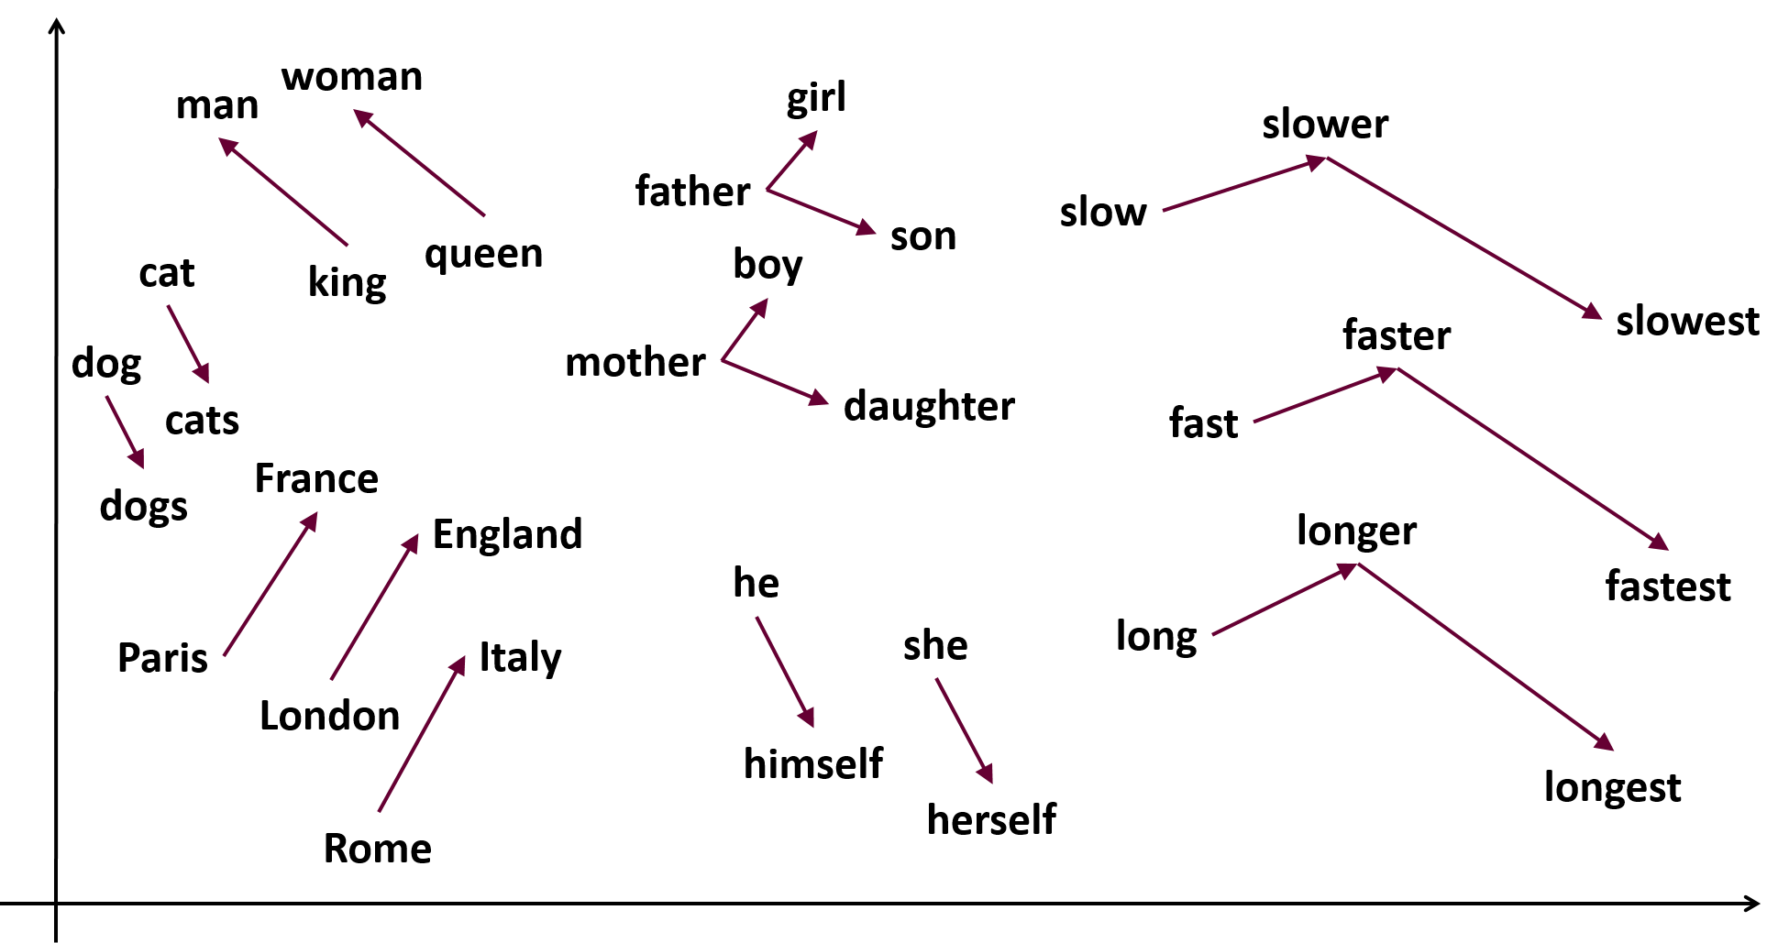
Trying to illustrate this idea
Notes:
https://medium.com/analytics-vidhya/implementing-word2vec-in-tensorflow-44f93cf2665f

Slide 40
How do you build something like this?
Continuous BagOfWords Model- Take all of the words around a word and try and predict what that word would be.
This is a <FOCUS WORD> Rainy Day. The sorts of words that fit into that space would be fairly close to each other logically in a vector space. The Model keeps adjusting vector values based on the words that come up in similar surrounding contexts.
Notes:
https://www.youtube.com/watch?v=MtM9QrCjuK4

Slide 41
How did we get here?
Deep Learning has had some pretty significant breakthroughs since 2018
Neural Networks were mainly Convolutional Neural Networks and Recurrent Neural Networks
They were improved upon with LSTM (Long Short-Term Memory) systems.

Slide 42
Sequence to Sequence learning
Seq2Seq are Neural networks that transform a given sequence into another sequence. Eg: Translating words from one language to another.
In the paper “Attention is all you Need” the mechanism of ‘Attention’ comes into play. Which looks at each part of an input sequence and decides which other parts of this sequence are important. This is a part of LSTMs (Long Short-Term Memories)
The car was blue
Notes:
https://arxiv.org/abs/1706.03762

Slide 43
ELMo
Extended Language Models
It’s a type of Contextualized word embedding made using 2 LSTMs to read from left to right and right to left to establish relationships between words in a sentence, and then concatenates them.
Notes:
https://arxiv.org/abs/1802.05365

Slide 44
Transformers
Similar to LSTMs but consists of 2 parts, an encoder and a decoder. Bring up style transfer example here.
Notes:
https://medium.com/inside-machine-learning/what-is-a-transformer-d07dd1fbec04

Slide 45
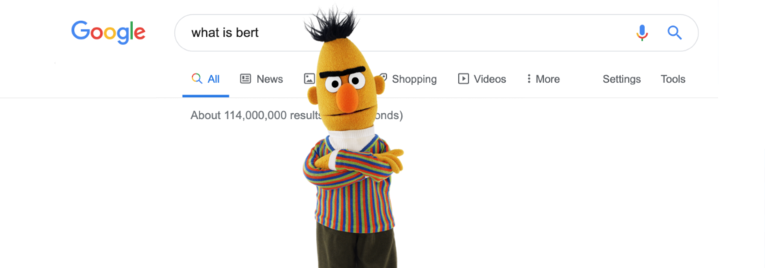
BERT
A pre-trained unsupervised Natural Language Processing model developed by Google in 2018
Notes:
Before, we dive into how we used BERT, we wanted to give a quick primer on what BERT is -> read slide, pre-trained, unsupervised: input data is not labeled

Slide 46


BERT Benefit
Pre-trained models solve challenge of lack of enough training data
Can use pre-trained models to fine tune on smaller-task specific datasets and improves accuracy drastically
Book Corpus:
2,500 million words
Wikipedia:
800 million words
BERT Explained: A Complete Guide with Theory and Tutorials
Notes:
One of the biggest challenges in NLP is the lack of enough training data. While there is a lot of text, you would need to create task-specific datasets

Slide 47
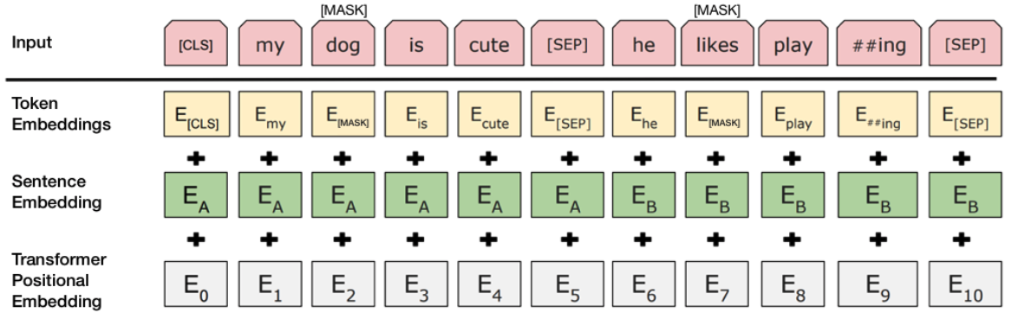
Input Schema BERT needs:
(Devlin and others, 2019)
Token Embeddings: A [CLS] token is added to the input word tokens at the beginning of the first sentence and a [SEP] token is inserted at the end of each sentence.
Sentence Embeddings: A marker indicating Sentence B is added to each token. This allows the encoder to distinguish between sentences
Positional Embeddings: A position embedding is added to each token to indicate its position in the sentence
Notes:
Embedding: a vector of numbers for each word in vocabulary – capture meanings, relationships between words, context of different words
And so how BERT works, is it takes an input: and has 3 fdifferent types of embeddings:
Token, Sentence and transformer positional
CLS – stands for classification:
SEP: separating sentences for next sentence prediction task
3 different types of embeddings:
Token: word or tokens of word-> play vs playing
So BERT will randomly MASK a word in the sentence
=================================
CLS: stands for classification
[SEP]: is for separating sentences for the next sentence prediction task. “http://mlexplained.com/2019/01/07/paper-dissected-bert-pre-training-of-deep-bidirectional-transformers-for-language-understanding-explained/”
Image is from paper: https://arxiv.org/pdf/1810.04805.pdf
“As input, BERT takes token embeddings as well as a couple of additional embeddings that provide some crucial metadata. One of these embeddings is the positional embedding. One limitation of the Transformer architecture is that - unlike RNNs - it cannot take the order of the inputs into account (i.e. it will treat the first and last tokens of the inputs exactly the same if they are the same word). To overcome this problem, BERT learns and uses positional embeddings to express the position of words in a sentence. These embeddings are added to the token embeddings before feeding them into the model.
BERT also takes segment embeddings as input. BERT can be trained on sentence pairs for tasks that take sentence pairs as input (e.g. question answering and natural language inference). It learns a unique embedding for the first and second sentences to help the model distinguish between the sentences.” - http://mlexplained.com/2019/01/07/paper-dissected-bert-pre-training-of-deep-bidirectional-transformers-for-language-understanding-explained/
Sentence Embeddings can also be referenced as segment embeddings!

Slide 48
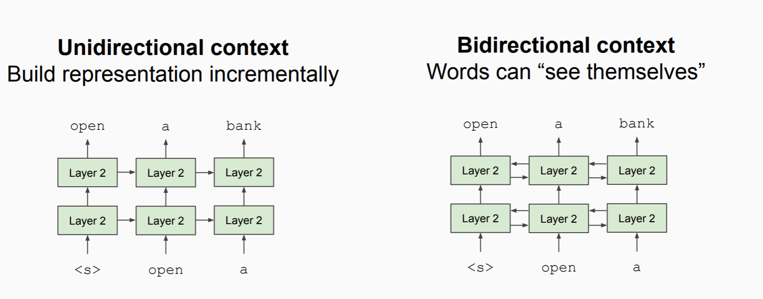
BERT Benefit
Bidirectional Context at the same time
-sensenten
We went to the river bank. vs I need to go to the bank to make a deposit.
Notes:
Word2vector: is unidirectional – left or right context only
Context:

Slide 49
BERT Benefit
Able to handle “uncommon words”
Sample text = “We are learning very Czernuszenko right now about embedding. Pay Attention”
Input = ['[CLS]', 'we', 'are', 'learning', 'very', 'c', '##zer', '##nus', '##zen', '##ko', 'right', 'now', 'about', 'em', '##bed', '##ding', '[SEP]', 'pay', 'attention’, [‘SEP’]]
Matches the roots of words
Notes:
BERT matches the roots of words. Therefore, if a word is misspelled, uncommon, or doesn’t exist, it will still run because BERT parses the roots. [ input = CLS token], SEP = punctuation

Slide 50




BERT Applications
Encode
Question Answering
Summarization
Classification
Convert plain English to BERT tokens, useful for clustering, similarity analysis between sentences, translation of sequences
Use sentence level similarity to find most likely answers to a given question in a given piece of context text
Identify the most important lines in a document, eliminate redundant ideas expressed multiple times
Once text is encoded, use them as vector features and add a neural network layer to build classifiers from it

Slide 51
Current Methods
Current state of the art models are Transformers, Longformers, LSTMs, Generative Adversarial Networks (GAN) and experimental models that combine new paradigms with more well established methods of capturing data (Clusterformers)
Large Language models continue to grow in use popularity, GPT2 is publicly accessible, GPT 3 and 4 are available throught OpenAIs platform
There are huge strides in Image synthesis, through Generative Adversarial Networks, (This person does not exist)
Training models from scratch is getting prohibitive. Neural Nets, large language models, etc are all becoming more and more black-box, harder to interpret and explain. A new trend of explainable AI is starting to emerge, and academia often (justifiably) frowns upon the use of closed source language models for data analysis.
The space is moving faster every day. By the time I’m done talking there’s probably a new specialized model published.

Slide 52

About Us
At Contoso, we empower organizations to foster collaborative thinking to further drive workplace innovation. By closing the loop and leveraging agile frameworks, we help business grow organically and foster a consumer first mindset.​

Slide 53




Solution
Close the gap
Target audience
Cost savings
Easy to use
Our product makes consumer lives easier, and no other product on the market offers the same features​
Gen Z (18-25 years old)
Reduce expenses for replacement products
Simple design that gives customers the targeted information they need​

Slide 54



Product Overview
Unique
First to market
Only product specifically dedicated to this niche market
First beautifully designed product that's both stylish and functional​
Tested
Authentic
Conducted testing with college students in the area​
Designed with the help and input of experts in the field ​

Slide 55
Product Benefits
Cool and stylish product​
Areas for community connections
Online store and market swap​

Slide 56
Company Overview

Slide 57



Business Model
Research​
Abstract​
Design​
We based our research on market trends and social media​
We believe people need more products specifically dedicated to this niche market​
Minimalist and easy to use ​

Slide 58
Market opportunity overview
$3b
$1b
$2b
Opportunity to build​
Fully inclusive market​
Total addressable market​
Freedom to invent​
Selectively inclusive market​
Serviceable available market​
Few competitors​
Specifically targeted market​
Serviceable obtainable market​

Slide 59
Market opportunity comparison
$3B
Opportunity to Build
Revenue over 12 months​
$2B
Freedom to Invent
Market share​
$1B
Few Competitors
Obtainable market​

Slide 60
Our competition
CoNTOSO
competitors
Our product is priced below that of other companies on the market​
Design is simple and easy to use, compared to the complex designs of the competitors​
Affordability is the main draw for our consumers to our product​
Company A​ Product is more expensive​
Companies B & C ​ Product is expensive and inconvenient to use​
Companies D & E​ Product is affordable, but inconvenient to use

Slide 61
Our competition graphic
convenient
Contoso
A
expensive
affordable
D
B
C
E
Inconvenient​

Slide 62
Growth strategy
How we’ll scale in the future
Feb 20xx
May 20xx
Oct 20xx
Roll out product to high profile or top-level participants to help establish the product​
Release the product to the general public and monitor press release and social media accounts​
Gather feedback and adjust product design as necessary​

Slide 63
Traction
Forecasting for success​
Key metrics
Revenue by year
 | clients | orders | Gross avenue | Net revenue
20XX​ | 10​ | 1100​ | $10,000​ | $7,000​
20XX​ | 20​ | 200​ | $20,000​ | $16,000​
20XX​ | 30​ | 300​ | $30,000​ | $25,000​
20XX​ | 40​ | 400​ | $40,000​ | $30,000​
20XX​ | 50​ | 500​ | $50,000​ | $40,000​
20XX | 10 | 1100 | $10,000 | $7,000

Slide 64
Two-year action plan
Draft blueprints​
Run focus groups​
Gather feedback​
20XX
Jan
Feb
Mar
Apr
May
Jun
Jul
Aug
Sep
Oct
Nov
Dec
Test design​
Launch design​
Deliver to client
20XX
Jan
Feb
Mar
Apr
May
Jun
Jul
Aug
Sep
Oct
Nov
Dec

Slide 65
financials
 | Year 1 | Year 2 | year 3
Detailers​ | 5,000​ | 40,000​ | 160,000​ | ​
Users​ | 50,000​ | 400,000​ | 1,600,000​ | ​
Sales​ | 500,000​ | 4,000,000​ | 16,000,000​ | ​
Average price per sale​ | 75​ | 80​ | 90​ | ​
Revenue @ 15%​ | 5,625,000​ | 48,000,000​ | 216,000,000​ | ​
Gross Profit​ | 5,625,000​ | 48,000,000​ | 216,000,000​ | ​
Expenses​ | ​ | ​ | ​ | ​
Sales & marketing​ | 5,062,500​ | 38,400,000​ | 151,200,000​ | ​
Customer service​ | 1,687,500​ | 9,600,000​ | 21,600,000​ | 70%​
Product development​ | 562,500​ | 2,400,000​ | 10,800,000​ | 10%​
Research​ | 281,250​ | 2,400,000​ | 4,320,000​ | 5%​
Total Expenses​ | 7,593,750​ | 52,800,000​ | 187,920,000​ | 2%​
EBIT | -1,968,750 | -4,800,000 | 28,080,000 | ​

Slide 66




Our team
Takuma Hayashi​​
Mirjam Nilsson​​
Flora Berggren​​
Rajesh Santoshi​​
President
Chief Executive Officer​
Chief Operations Officer​
VP Marketing​

Slide 67

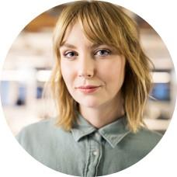





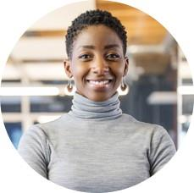
Our team
Takuma Hayashi​​
Mirjam Nilsson​​
Flora Berggren​​
Rajesh Santoshi​​
President
Chief Executive Officer​
Chief Operations Officer​
VP Marketing​
Graham Barnes​
Rowan Murphy​
Elizabeth Moore​
Robin Kline​
VP Product​
SEO Strategist​
Product Designer​
Content Developer​

Slide 68
Funding
12K
14K
32K
82K
Property
Angel Investments
Cash
Shares
Revenue obtained from property rentals​
Amount obtained through other investors​
Liquid cash we have on hand​
Number of shares converted into USD​

Slide 69
Thank you
Neil Kattampallil
nak3t@virginia.edu

